Slide 1

CFA Institute Research Challenge
Carlos Cuesta Albornoz
Caleb Gattis
Madison McNeile
Austin Parkins
Arielle Sedillo

Slide 2

Company Overview
Unless stated otherwise, all numbers are as of report date
Recommendation: HOLD
Target Price: $87.33
Current Price: $88.62
Report Price: $79.25
Target Price: $87.33
Company Overview
Industry Overview & Competitive Positioning
Financial Analysis
Valuation
Investment Risks
Conclusion
Notes:
vehicle financing
car reviews
vehicle trade- ins
7-day return policy
certification of vehicles
warranty coverage.
Recommendation: HOLD

Slide 3


Slide 4
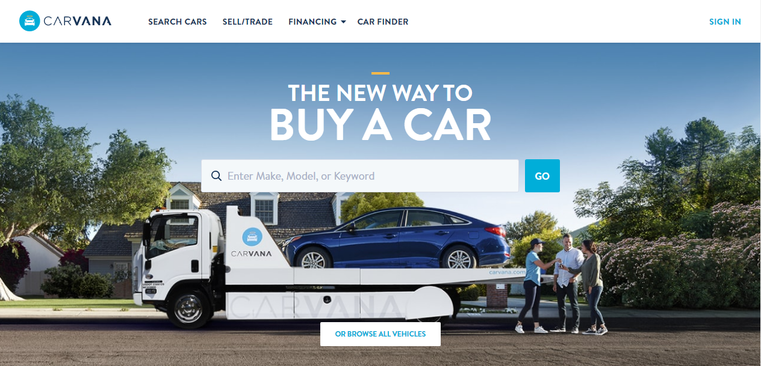









Company Overview
Ernest Garcia III
Ryan Keeton
Financing Car Reviews Trade-Ins Vehicle Certification 7 Day Returns - Warranty
Ben Huston
Source: Carvana Corporate Governance
Company Overview
Industry Overview & Competitive Positioning
Financial Analysis
Valuation
Investment Risks
Conclusion
Notes:
vehicle financing
car reviews
vehicle trade- ins
7-day return policy
certification of vehicles
warranty coverage.
Recommendation: HOLD

Slide 5
US Automotive Retail Industry
Trends
Over 600,000 tech-savvy customers coming of age
Average price is increasing, so is the difference
Company Overview
Industry Overview & Competitive Positioning
Financial Analysis
Valuation
Investment Risks
Conclusion

Slide 6

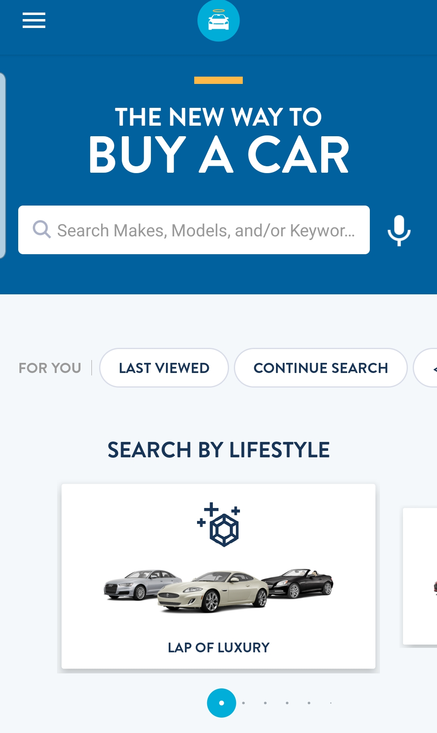
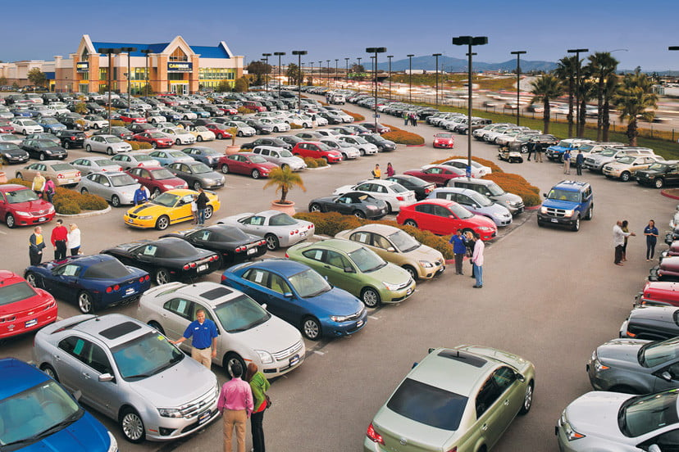
Competitors
VS
Company Overview
Industry Overview & Competitive Positioning
Financial Analysis
Valuation
Investment Risks
Conclusion

Slide 7
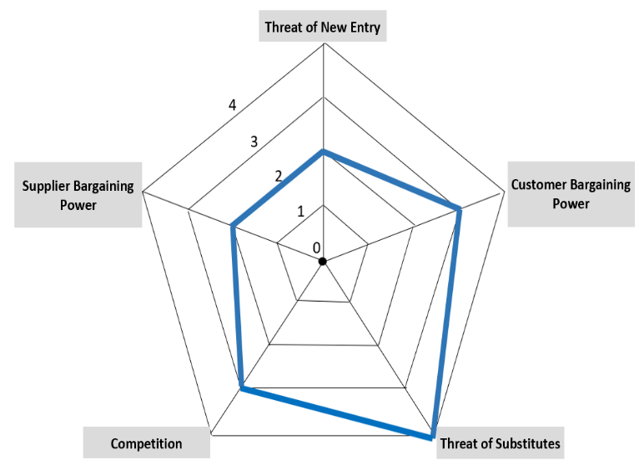
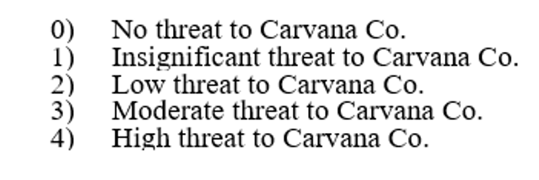
Porter’s Five Forces
Company Overview
Industry Overview & Competitive Positioning
Financial Analysis
Valuation
Investment Risks
Conclusion

Slide 8
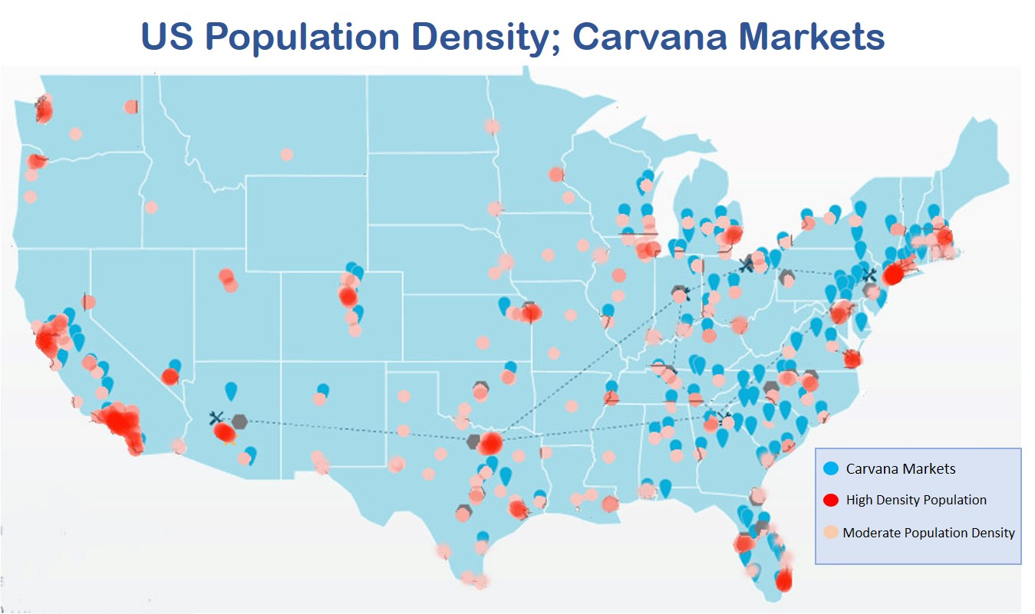
Competitive Positioning
Company Overview
Industry Overview & Competitive Positioning
Financial Analysis
Valuation
Investment Risks
Conclusion

Slide 9
Competitive Advantage
Vehicle Acquisition
Inspection & Reconditioning
E-Commerce
In-House Financing
Delivery & Distribution
Warranty
Company Overview
Industry Overview & Competitive Positioning
Financial Analysis
Valuation
Investment Risks
Conclusion

Slide 10
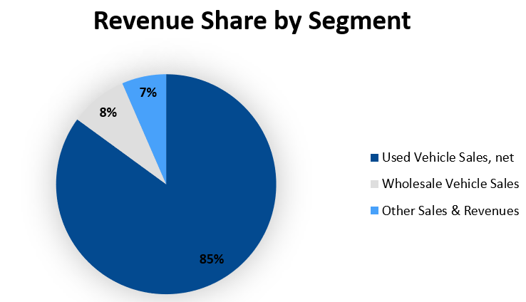
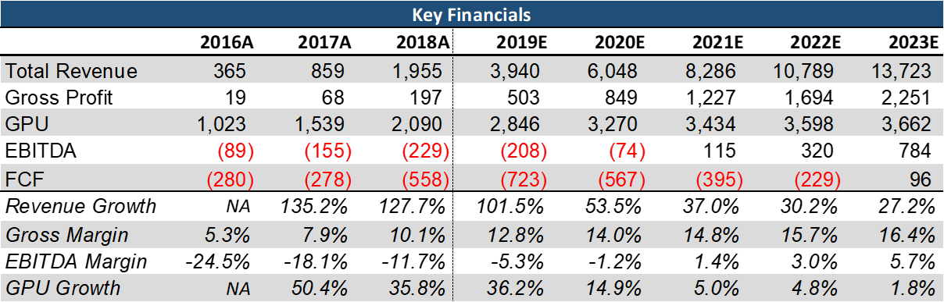
Financial Analysis
Revenue
Segments
Growth
Debt Level
Operations
Expansion
($ in millions, except GPU)
Company Overview
Industry Overview & Competitive Positioning
Financial Analysis
Valuation
Investment Risks
Conclusion
Notes:
Graph

Slide 11
Reaching Profitability
Company Overview
Industry Overview & Competitive Positioning
Financial Analysis
Valuation
Investment Risks
Conclusion

Slide 12
Valuation
Target Price
Methodologies
Discounted Cash Flow Valuation
10-Year Projection Period
Perpetuity Growth Method
Assumptions
EV/Sales Valuation
Why EV/Sales?
Comparable Peers
DCF
50%
EV/Sales
50%
Company Overview
Industry Overview & Competitive Positioning
Financial Analysis
Valuation
Investment Risks
Conclusion

Slide 13
Scenario Breakdown
Cases
Bull Case - $140.68
Revenue CAGR ~27%
3.5x EV/Sales
Base Case - $87.33
Revenue CAGR ~24%
2.5x EV/Sales
Bear Case - $52.81
Revenue CAGR ~22%
1.5x EV/Sales
Base
Bull
Bear
Company Overview
Industry Overview & Competitive Positioning
Financial Analysis
Valuation
Investment Risks
Conclusion
Notes:
Column chart

Slide 14
DCF Assumptions
23.8% CAGR
Company Overview
Industry Overview & Competitive Positioning
Financial Analysis
Valuation
Investment Risks
Conclusion

Slide 15
WACC Assumptions
Beta Regression
Company Overview
Industry Overview & Competitive Positioning
Financial Analysis
Valuation
Investment Risks
Conclusion

Slide 16
Relative Valuation
Company Overview
Industry Overview & Competitive Positioning
Financial Analysis
Valuation
Investment Risks
Conclusion

Slide 17
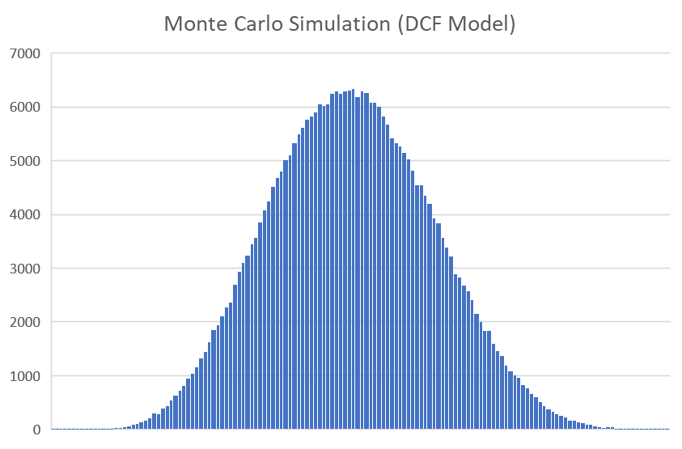
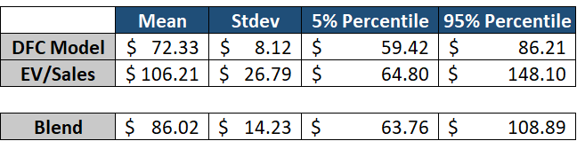
Monte Carlo
Cases
Bull Case - $140.68
Base Case - $87.33
Bear Case - $52.81
Monte Carlo Simulation
Company Overview
Industry Overview & Competitive Positioning
Financial Analysis
Valuation
Investment Risks
Conclusion
Notes:
Column chart

Slide 18
Valuation
$87.33
Target Price
$74.65
DCF
50%
$100.01
EV/Sales
50%
Valuation Confirms HOLD Recommendation
Company Overview
Industry Overview & Competitive Positioning
Financial Analysis
Valuation
Investment Risks
Conclusion

Slide 19
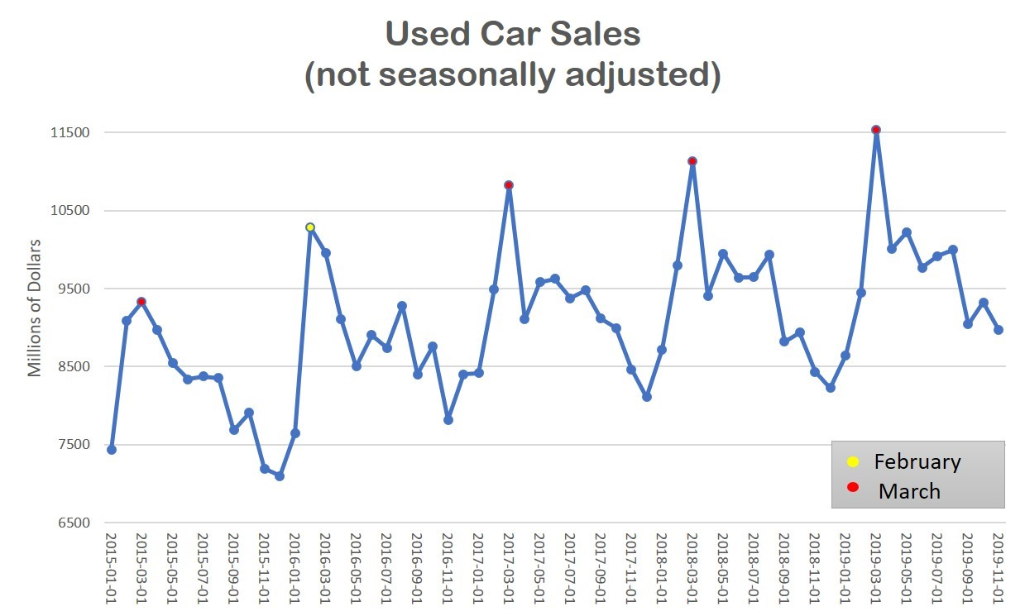
Investment Risks
Systematic Risks
Business Specific Risks
Tariffs
Taxes
Interest Rate
Seasonality
Subprime Auto Loans
Low Credit Rating
Profitability
Financing Dependency
Company Overview
Industry Overview & Competitive Positioning
Financial Analysis
Valuation
Investment Risks
Conclusion

Slide 20
Conclusion
Recommendation: HOLD
Target Price: $87.33
Current Price: $88.62
Strong Points
Highly Fragmented Industry Ripe for Disruption
Proven Growth Strategy, Market Expansion Blueprint
Concerns
Fundamentals
Growth Premium Likely Reflected in Current Valuation
Company Overview
Industry Overview & Competitive Positioning
Financial Analysis
Valuation
Investment Risks
Conclusion

Slide 21

Sources
About the author(s) Ben Ellencweig is a partner in McKinsey’s Stamford office. “Used Cars, New Platforms: Accelerating Sales in a Digitally Disrupted Market.” McKinsey & Company, www.mckinsey.com/industries/automotive-and-assembly/our-insights/used-cars-new-platforms-accelerating-sales-in-a-digitally-disrupted-market.
Arlena Sawyers Automotive News. “CarMax Opens First Used Car Dealership in Michigan.” Crain's Detroit Business, 28 Nov. 2016, www.crainsdetroit.com/article/20161128/NEWS/161129890/carmax-opens-first-used-car-dealership-in-michigan.
“Bureau of Labor Statistics Data.” U.S. Bureau of Labor Statistics, U.S. Bureau of Labor Statistics, data.bls.gov/timeseries/LNS14000000.
Colias, Mike, and Nora Naughton. “Car Sales Boom Hit the Brakes in 2019.” The Wall Street Journal, Dow Jones &amp; Company, 3 Jan. 2020, www.wsj.com/articles/car-sales-boom-hit-the-brakes-in-2019-11578071698.
“Consumer Price Index: 2019 in Review.” U.S. Bureau of Labor Statistics, U.S. Bureau of Labor Statistics, 16 Jan. 2020, www.bls.gov/opub/ted/2020/consumer-price-index-2019-in-review.htm.
Ellencweig Ben Ellencweig is a partner in McKinsey’s Stamford office, Ben, et al. “Used Cars, New Platforms: Accelerating Sales in a Digitally Disrupted Market.” McKinsey & Company, www.mckinsey.com/industries/automotive-and-assembly/our-insights/used-cars-new-platforms-accelerating-sales-in-a-digitally-disrupted-market.
“Federal Open Market Committee.” Board of Governors of the Federal Reserve System, 29 Jan. 2020, www.federalreserve.gov/monetarypolicy/fomc.htm.
“Form 10-K” Carvana, Co., 2019, https://otp.tools.investis.com/clients/us/carvana/SEC/sec-show.aspx?Type=html&FilingId=13258789&CIK=0001690820&Index=10000
“Form 10-Q” Carvana, Co., 2019, https://otp.tools.investis.com/clients/us/carvana/SEC/sec-show.aspx?FilingId=13723864&Cik=0001690820&Type=PDF&hasPdf=1
“Gross Domestic Product, Third Quarter 2019 (Third Estimate); Corporate Profits, Third Quarter 2019 (Revised Estimate): U.S. Bureau of Economic Analysis (BEA).” Gross Domestic Product, Third Quarter 2019 (Third Estimate); Corporate Profits, Third Quarter 2019 (Revised Estimate) | U.S. Bureau of Economic Analysis (BEA), www.bea.gov/news/2019/gross-domestic-product-third-quarter-2019-third-estimate-corporate-profits-third-quarter.
Hill, Charles W. L., et al. Strategic Management Theory &amp; Cases: An Integrated Approach. Cengage Learning, Inc, 2019.
“Letter to Shareholders, Q3 2019” Carvana, Co., 2019, https://investors.carvana.com/~/media/Files/C/Carvana-IR/documents/events/q3-2019-cvna-shareholder-letter.pdf
Looker, Rob. “Why Used Cars Offer 'Compelling Alternative' to New as Average Prices Rise.” RoadLoans, 30 July 2019, roadloans.com/blog/average-car-price.
“NADA Issues Analysis of Second Quarter 2019 Auto Sales.” NADA, www.nada.org/patrick-manzi-second-quarter-2019-auto-sales-economic-analysis/.
“Personal Income and Outlays, November 2019: U.S. Bureau of Economic Analysis (BEA).” Personal Income and Outlays, November 2019 | U.S. Bureau of Economic Analysis (BEA), www.bea.gov/news/2019/personal-income-and-outlays-november-2019.
Ross, Stephen A., et al. Fundamentals of Corporate Finance. McGraw-Hill Education, 2019.
Timiraos, Nick. “Federal Reserve Holds Benchmark Rate Steady.” The Wall Street Journal, Dow Jones &amp; Company, 30 Jan. 2020, www.wsj.com/articles/fed-likely-to-hold-interest-rates-steady-11580293802.
Tseng, Nin-Hai. “Why Car Companies Can't Win Young Adults.” Fortune, Fortune, 30 May 2014, fortune.com/2013/08/16/why-car-companies-cant-win-young-adults/.
“The US-China Trade War: A Timeline.” China Briefing News, 17 Jan. 2020, www.china-briefing.com/news/the-us-china-trade-war-a-timeline/.
“What Is Net Promoter?” Net Promoter Network, www.netpromoter.com/know/.
“World Economic Outlook Update, January 2020: Tentative Stabilization, Sluggish Recovery?” IMF, 1 Jan. 2020, www.imf.org/en/Publications/WEO/Issues/2020/01/20/weo-update-january2020.
Sources

Slide 22
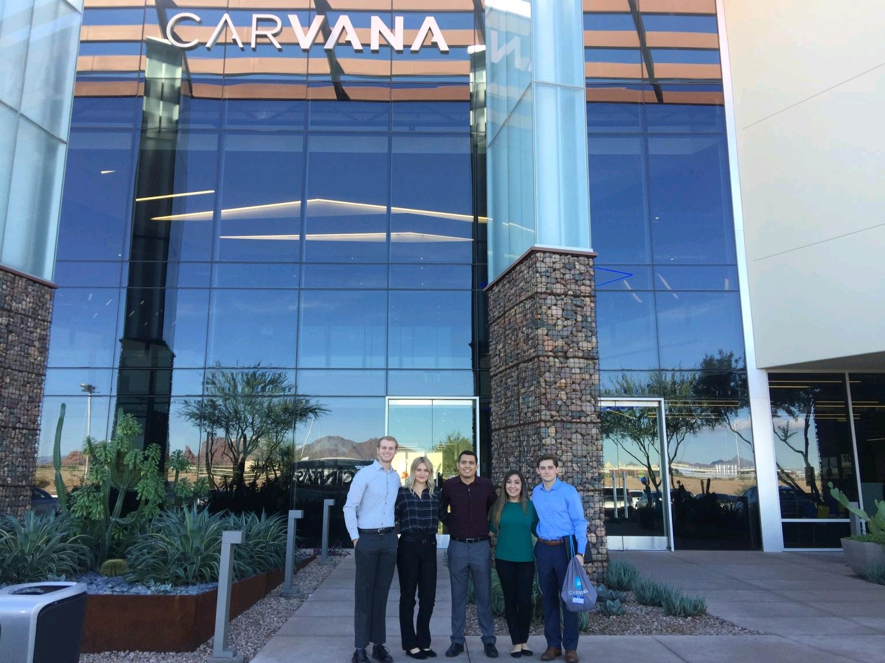
Questions
Sources

